Slide 1
COVID-19:
Exploratory Data Analysis
and Visualization
Avani Jain, Toby Sheung, Michael Wesner

Slide 2
Project Proposal
In this project our aim is to do time series analysis using COVID-19 dataset which is available from the dates 1st January 2020 to 3rd October 2020 and performing exploratory data analysis on different features present in the dataset. We are implementing different types of visualization. Attempt to find most important features of dataset using machine learning.

Slide 3
Steps
Find COVID-19 data for world with data available for each country
Find more detailed COVID-19 data for United States with data available for each state
Preprocess all data
Exploratory data analysis
Statistical and time series analysis
Visualizations
Machine learning to find most important features in data

Slide 4
Datasets
Our world in data: https://covid.ourworldindata.org/
Covid tracking: https://covidtracking.com/data
Social distancing index: https://dataverse.harvard.edu/dataset.xhtml?persistentId=doi:10.7910/DVN/ZAKKCE
CDC: https://data.cdc.gov/NCHS/Provisional-COVID-19-Death-Counts-by-Sex-Age-and-S/9bhg-hcku

Slide 5
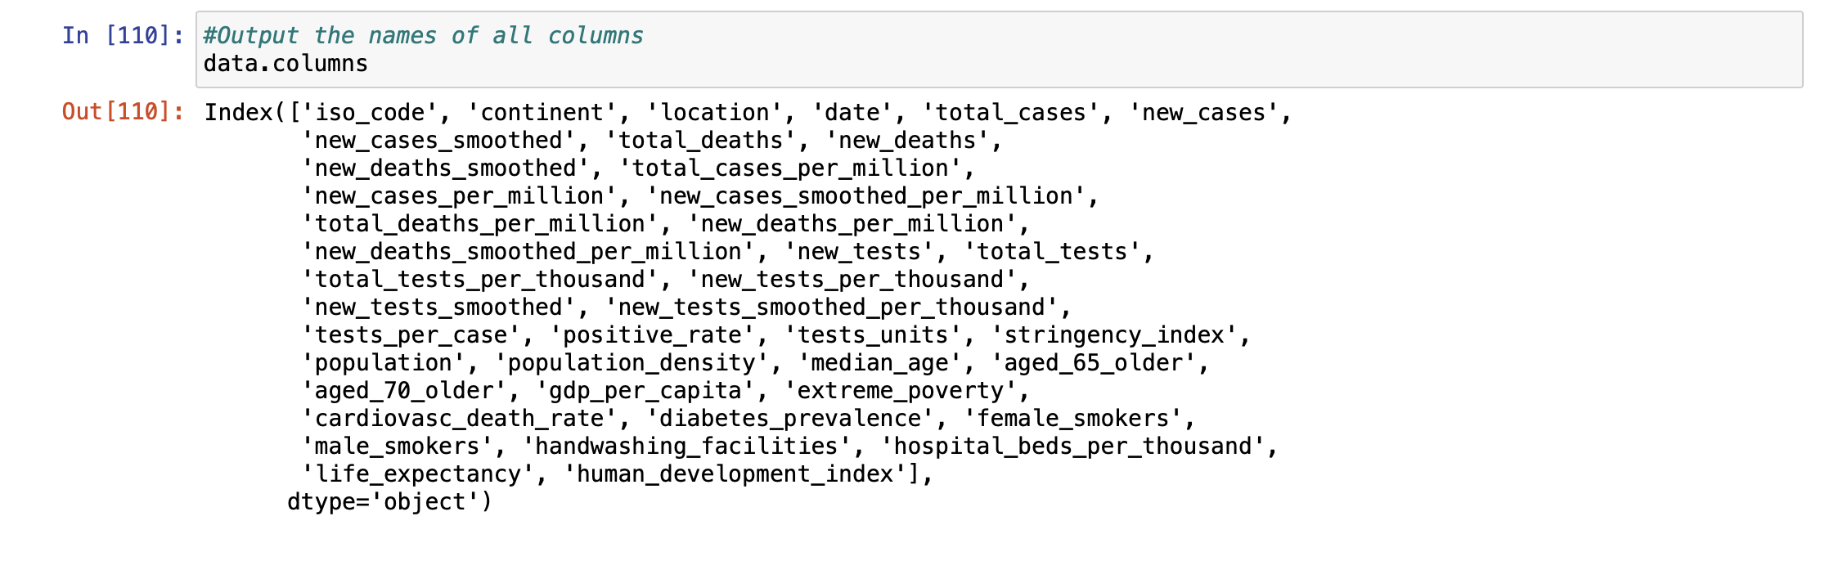
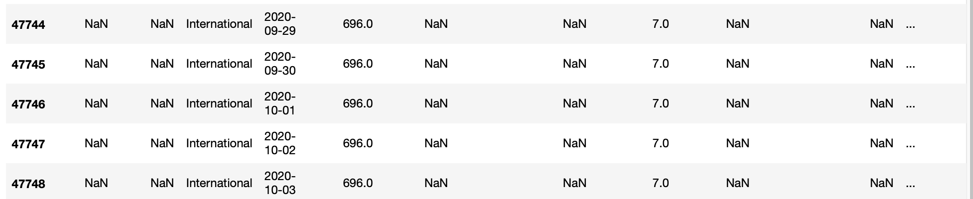
Removal of Data
Removal of smoothed columns: new_cases_smoothed, new_cases_smoothed_per_million, etc.
Removal of not detailed variables: tests_units, stringency_index
Deleted rows with Location = International (not enough information)
Deleted locations that do not have all 278 dates

Slide 6
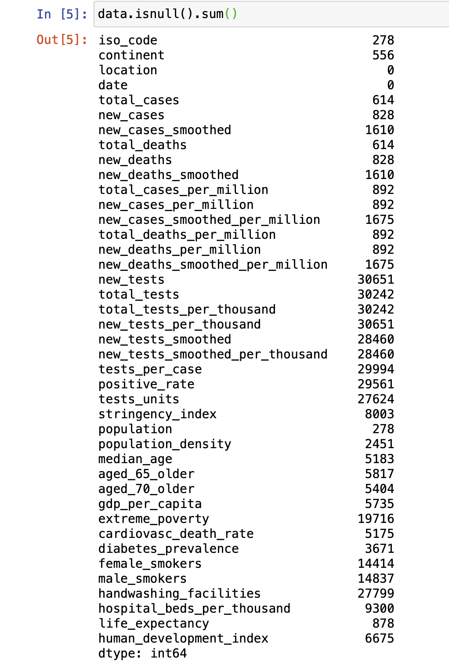
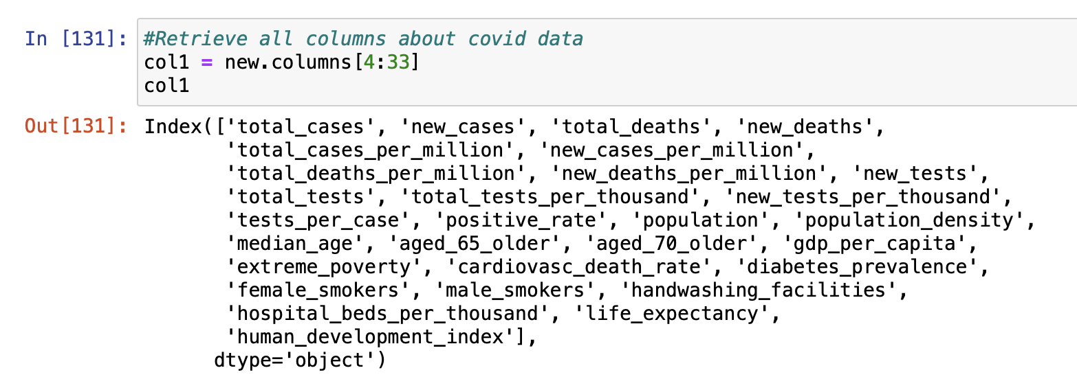
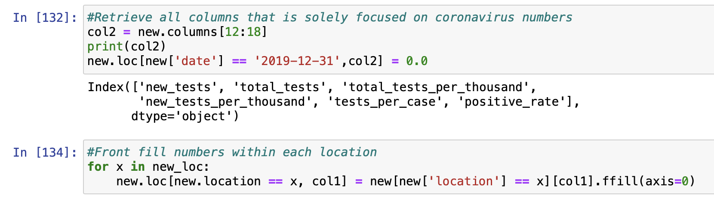
Null Values
To remove null values, we front filled numbers within each location
Focusing only on columns about covid data not about population and age

Slide 7
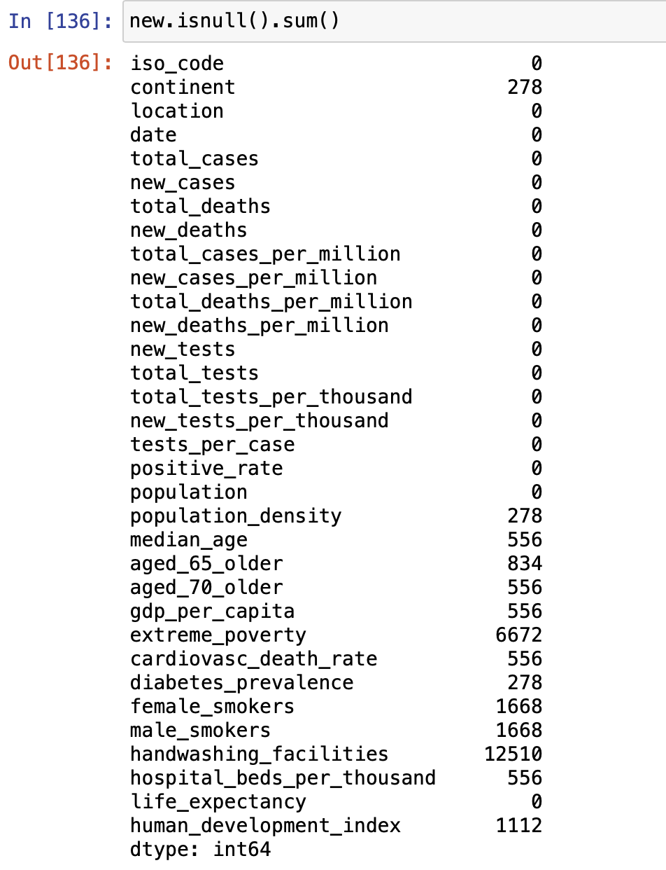
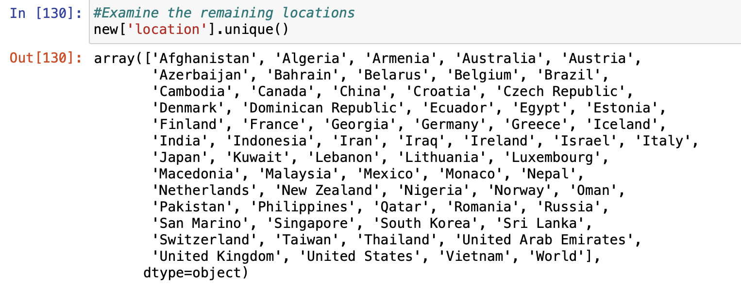
Clean Covid-19 Dataset
65 unique locations
33 columns
18070 rows
Any variables related to covid-19 numbers, have no remaining null values

Slide 8
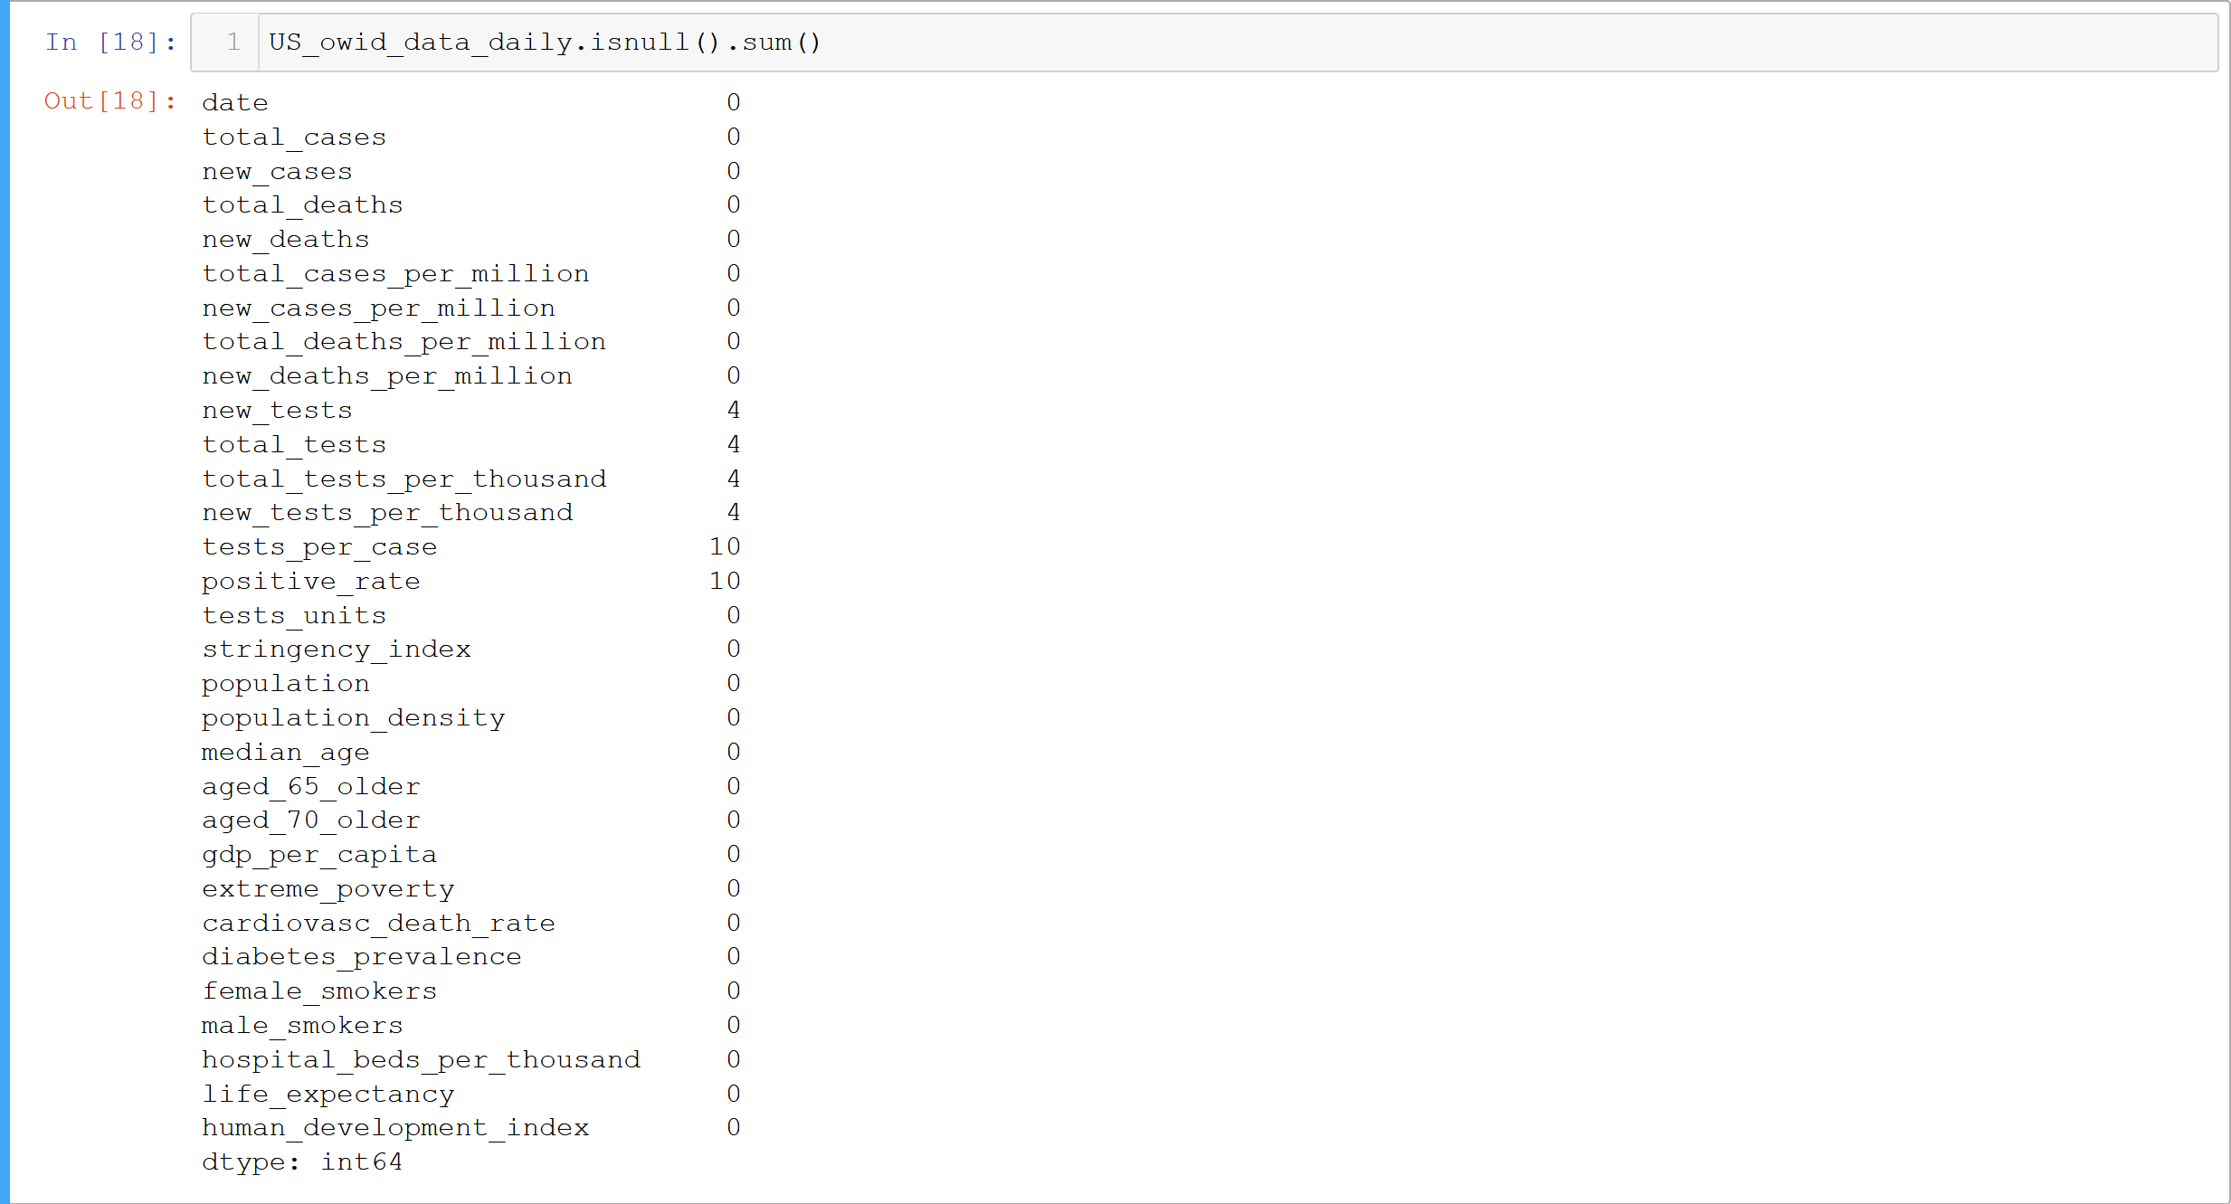
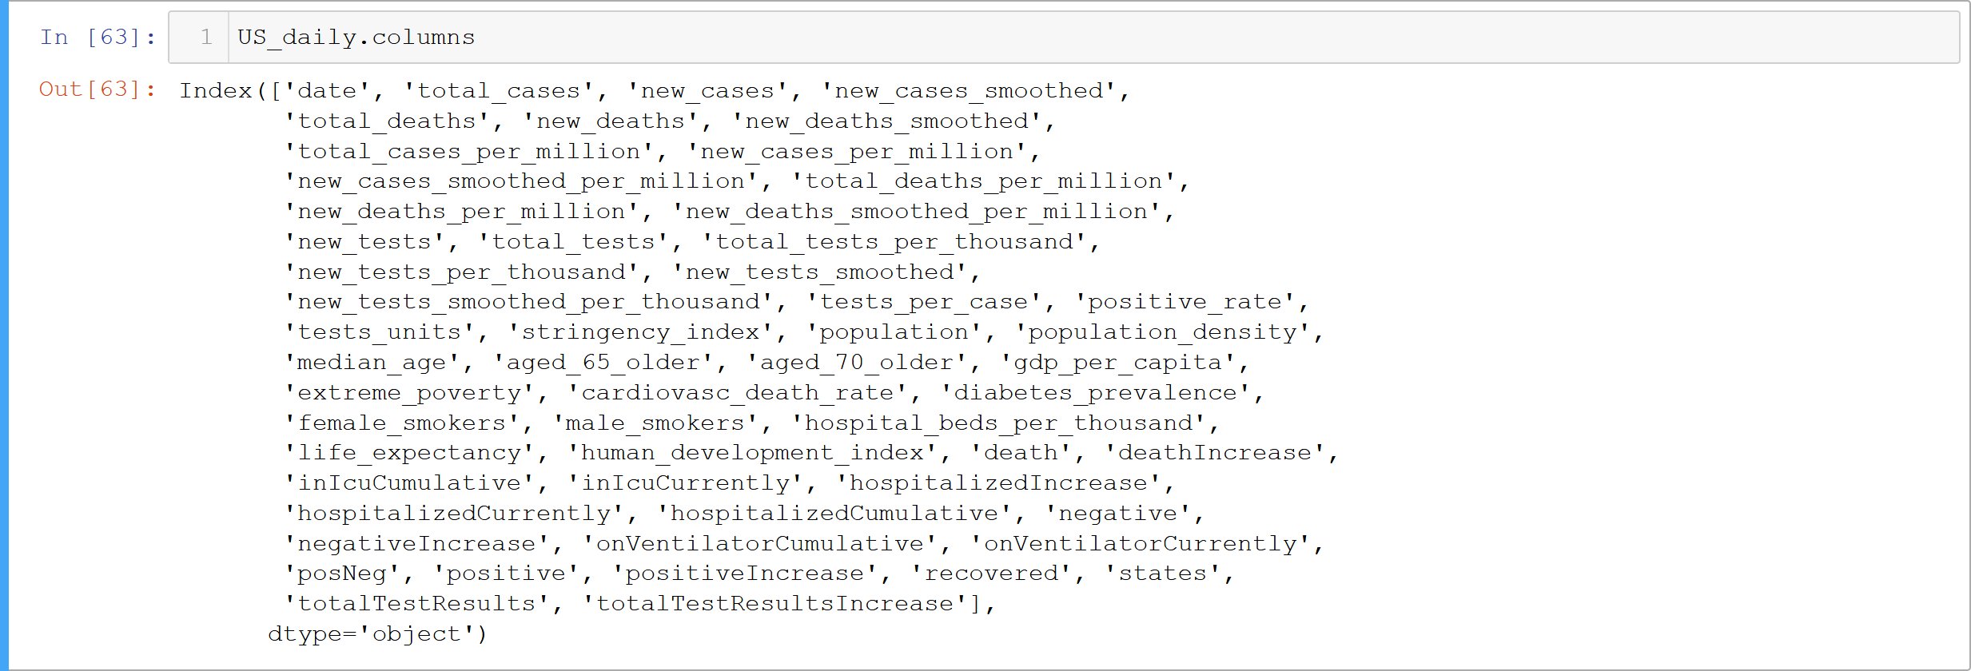
Split US from owid data, remove null values,
and merge with covid tracking

Slide 9
Completed data visualizations

Slide 10
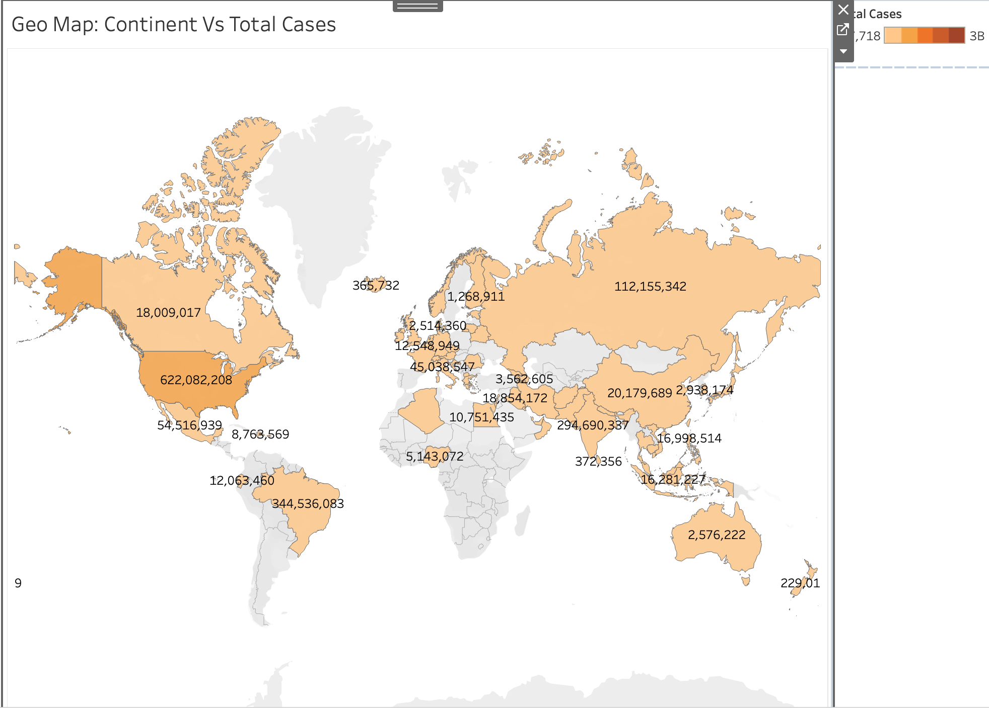

Slide 11
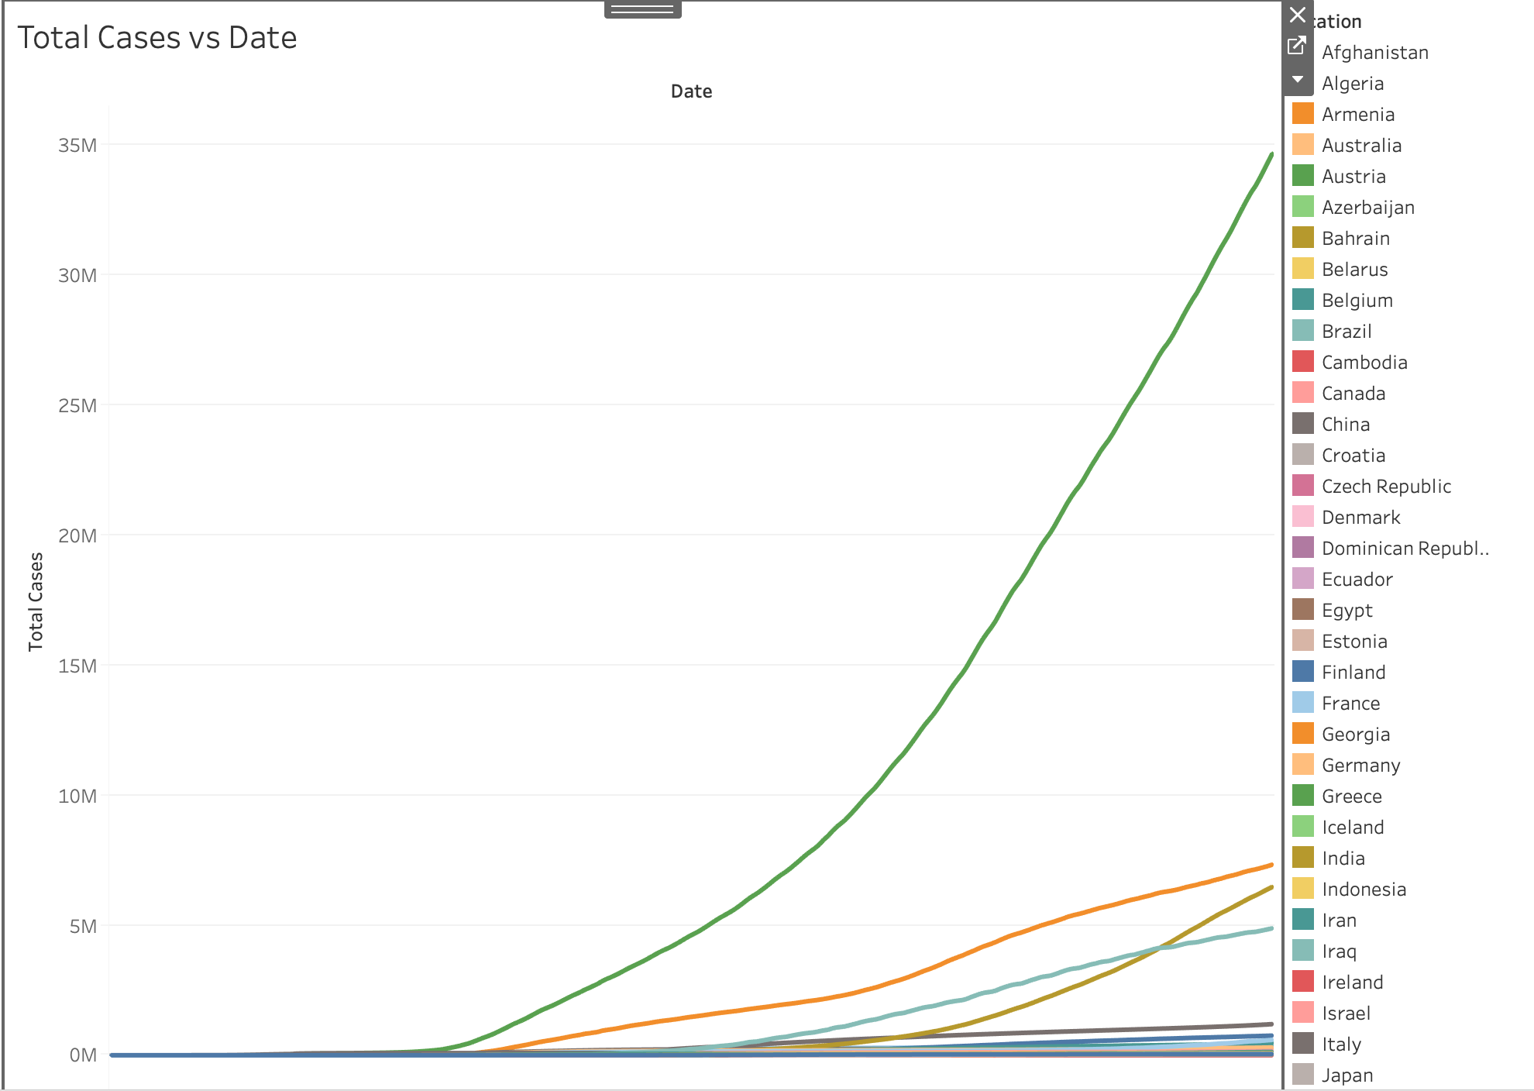

Slide 12
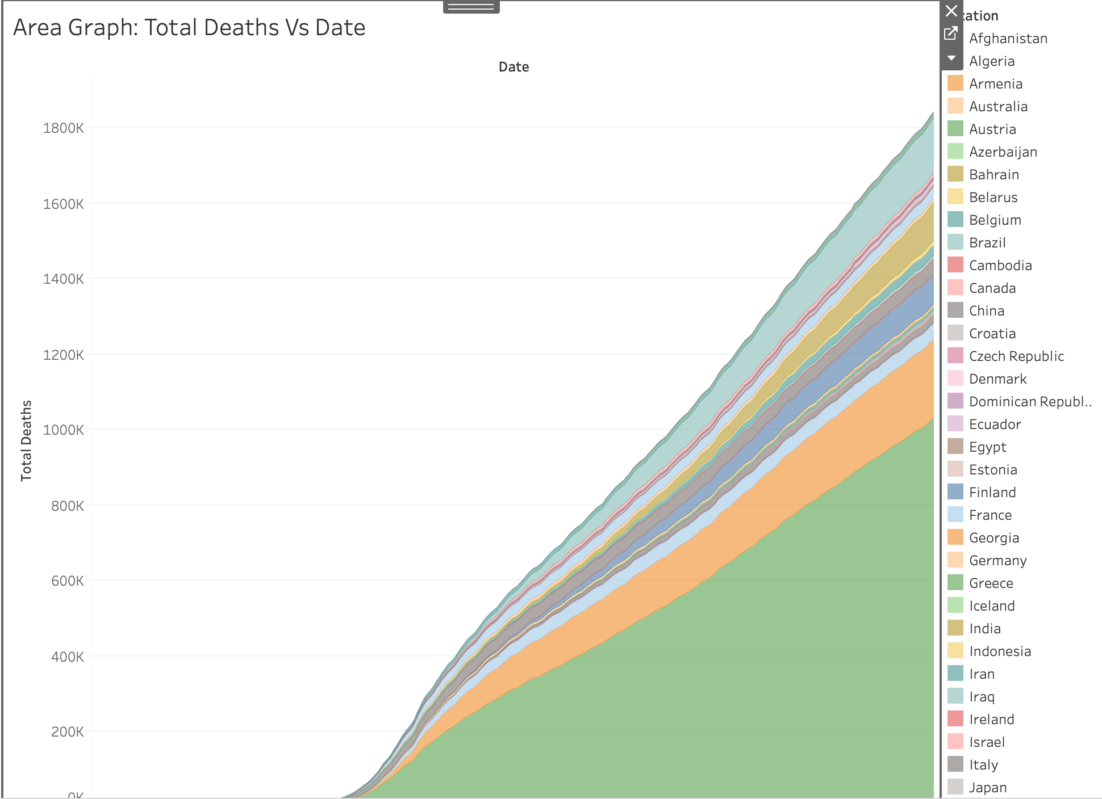

Slide 13
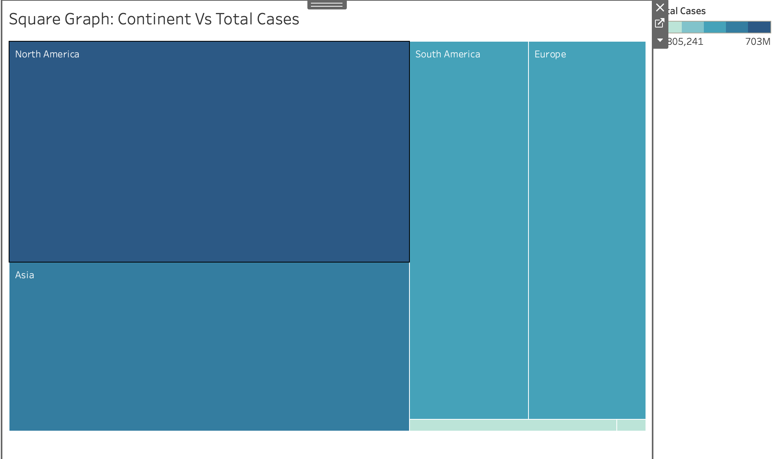

Slide 14
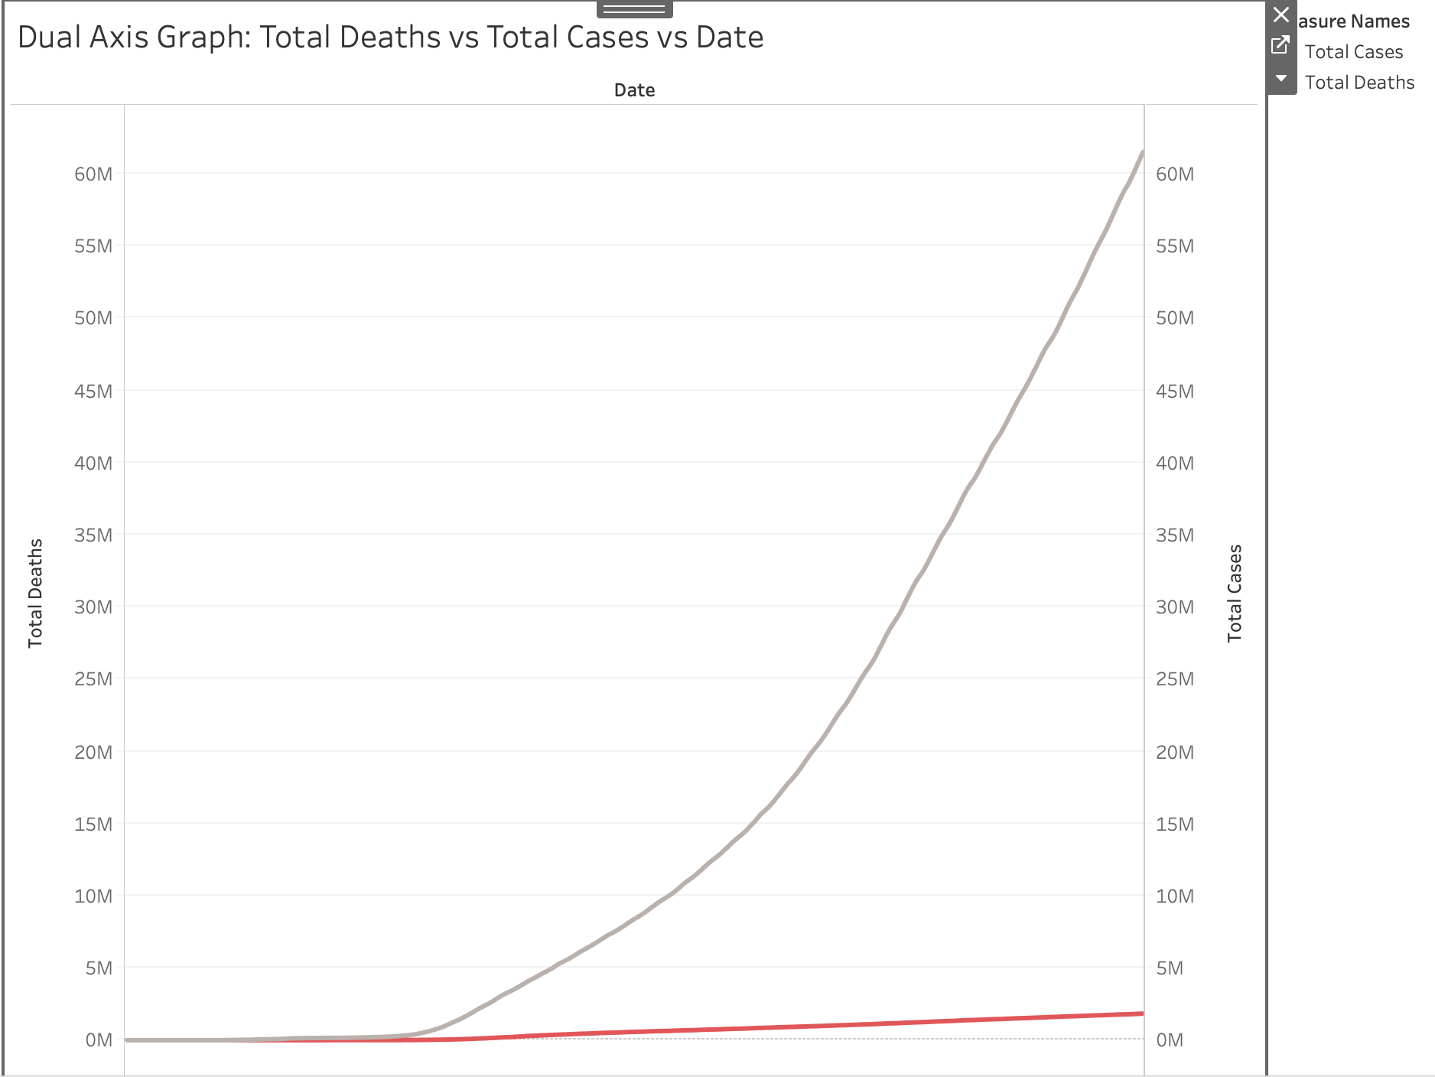

Slide 15
Future Steps
Continue with preprocessing datasets
Make visualizations for the most at risk age populations
COVID-19 visualizations according to the gender
Statistical analysis
Machine learning to find feature importance
Github: https://github.com/MWesner3344/DSCI-591

